Slide 1
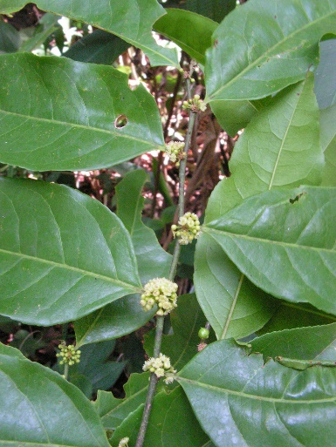
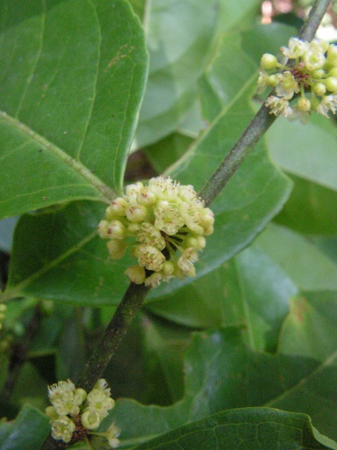
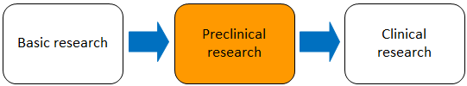
PHYTOTERAPIC FORMULATION FOR TREATMENT OF GASTRIC ULCERS IN ANIMALS.
ALBERTO JOSÉ CAVALHEIRO; ANDRÉ GONZAGA DOS SANTOS; ARISTEU GOMES TININIS; JAYME ANTÔNIO ABOIM SERTIÉ; MARCELO RODRIGUES; RICARDO GOMIDE WOISKY DO RIO; VANDERLAN DA SILVA BOLZANI;
INTRODUCTION
Caused mainly by stress and eating habits, disturbances of the gastrointestinal tract, especially ulcerative pathologies, are considered as one of the characteristic affections of modern life and its consequent urbanization. Among the drugs most consumed to treat it, the group of anti-ulcer tops the list of best sellers for the tenth consecutive year. These drugs, however, result in elevated gastric juice pH and decreased activity of digestive enzymes, resulting in lesions in the gastric mucosa and, consequently, facilitating the installation of opportunistic infections.
Gastritis is also a common disease in small animals, such as dogs and cats, and is diagnosed in 35% of the animals with a history of chronic vomiting, in addition to 26 to 48% of affected asymptomatic dogs. Its main causes are medications prescribed to treat inflammation, pain or fever, as well as inadequate dietary habits and infection by parasites..
In light of this, the present discovery provides pharmaceutical formulations containing extracts, active fractions and / or compounds isolated from Casearia sylvestris, a common plant in South America, known as high healing power and to present a significant anti-ulcerogenic action, aiming to offer an effective treatment to gastrointestinal disorders and ulcers in humans and animals.
APPLICATION AND TARGET MARKET
The present invention serves as a tool in the area of Health and Care (Human and Animal) for the treatment and prevention of disorders of the gastrointestinal tract, especially gastritis and gastroduodenal ulcer, through pharmaceutical formulations containing the active ingredient of Casearia sylvestris and its applications in medicines.
Figures - Leaf and flower of the species Casearia sylvestris, popularly called guaçatonga..
DEVELOPMENT STAGE
Area: Health and Care (Human and Animals); Others; 0005/2009
SUPPORT AND FOMENTATION: process no 03/02176-7 São Paulo Research Foundation (FAPESP). “Opinions, hyphoteses and conclusions or reccomendations expressed in this material are the resposability of the author(s) and not necessarily reflect the vision of FAPESP”.
CNPq;
Institute of Chemistry – USP.
Patent protect under the nº: PI 0900645-1
São Paulo Pole
alelima@usp.br www.patentes.usp.br

